Slide 1

Lodge Farm Education
Whole School Vision and Ethos
Vision
At Lodge Farm, we believe that learning is a lifelong journey filled with curiosity, adventure, and creativity. We want our pupils to have a genuine passion for learning and develop a resilience to overcome any challenge.
We enhance and inspire each pupil’s quality of life through the delivery of a relevant, purposeful and meaningful curriculum. We provide personalised support in the pupil’s developments including personal, social, physical and cognitive skills to raise high aspirations for each learner.
The holistic, nurturing and therapeutic approach provides a safe learning environment for all pupils to be inspired, grow and have a strong voice within the school community.
Ethos
We will value in which way each child is unique: celebrating diversity and valuing the importance of each other within our community.
We will demonstrate the highest standards of respect and empathy of others regardless of ability, gender, ethnicity or religion.
We will uphold high expectations around behaviour, nurtured in a high trust environment which will promote independence.
We will be relentless in our endeavours to build secure relationships with each other based on mutual respect.
Therapeutic Approach
Our highly experienced staff team work within a PACE style framework; whereby, acceptance and empathy underpin all aspects of communication and interactions with the pupils.
Regular staff training, guided by a professional psychotherapist ensures staff have the current skills and knowledge to create the opportunities for all pupils to engage and succeed.
The farm location creates the right environment for our therapeutic approach.

Slide 2
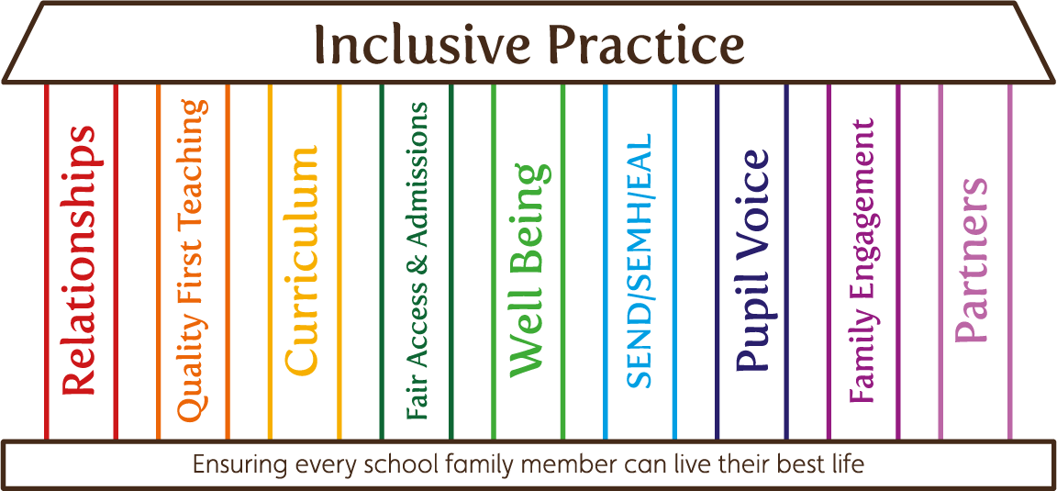
Lodge Farm Education
Core Values
Integrity.
To uphold the highest standards of honesty with the ability and desire to stand up for what is right; developing a strong moral compass that guides you to do the right thing when nobody's watching.
Responsibility.
To take responsibility for your actions and choices; to make others feel valued and respected; to contribute and fully embrace our school community.
Endeavour.
To endeavour to always do your best to face the challenges of school life and beyond; to try for the sake of others as well as the individual; to be consistent in all we do and strive for greatness.
Bravery.
To be brave when taking risks and facing fears; to be a strength for others when they question their own strength; to remember, it is going to be hard, but hard is not impossible.
Empathy.
To have the ability to relate to, and connect with, others for the purpose of inspiring and empowering their lives; to demonstrate humility when supporting others to be able to see, hear and feel from the position of another.

Slide 3
Lodge Farm Education Curriculum Pathway
When the pupils arrive, they are assessed using CAT4 and other in school assessments to select which pathway the pupil is going to access within their education. The pupil’s placement will be reviewed on a regular basis to ensure the highest quality of teaching occurs.
Inspire Pathway
Vocational based pathway
Portfolio’s and non-examination assessment where possible
Adaptive teaching essential including additional time for processing
Topics may be altered for interest and motivation
Formal Pathway
Follows a National Curriculum sequence
Examination based assessments
Adaptive teaching to challenge and extend knowledge and skills
Topics fixed through the scheme of work
Mixture of independent, peer and group work to work collaboratively

Slide 4
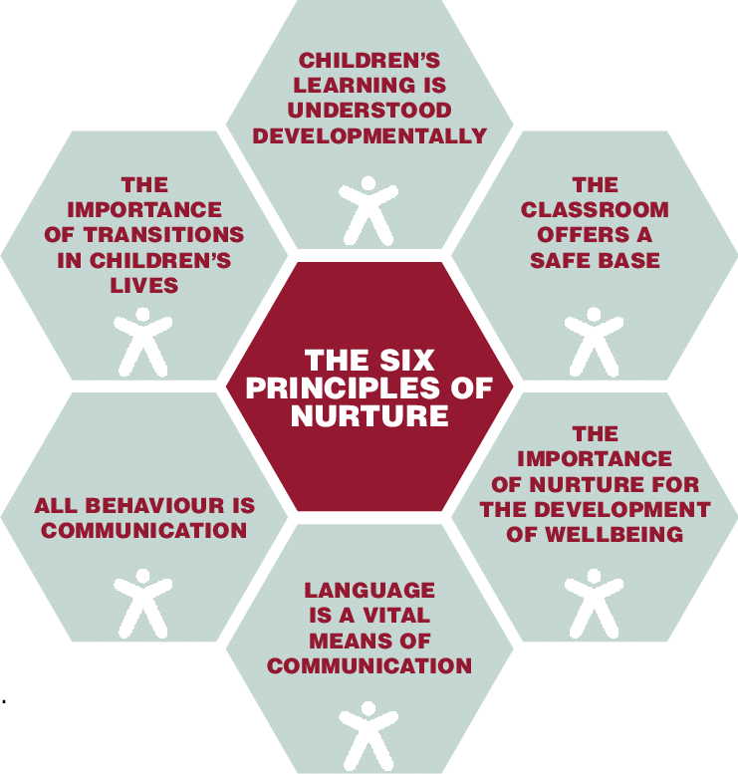
Lodge Farm Education Curriculum Pathway
When the pupils arrive, they are assessed using CAT4 and other in school assessments to select which pathway the pupil is going to access within their education. The pupil’s placement will be reviewed on a regular basis to ensure the highest quality of teaching occurs.
Inspire Pathway
Vocational based pathway which includes core national curriculum subjects. Due to the attainments of the pupils, they will be working at significantly lower than age-expected.
A more nurture approach towards learning and academic progress to create a holistic approach with a higher level of processing time for each individual.
High level of scaffolding and adult support to promote engagement and motivation. Some pupils may need a higher level of reassurance throughout their learning.
Repetition of knowledge and skills to aid memory. Topics may be altered for interest and motivation.
Extra interventions and work in relation to emotional regulation to provide each pupil effective tools to self-regulate.
Portfolio’s and non-examination assessment where possible.

Slide 5
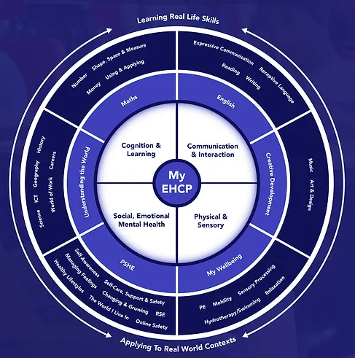
Lodge Farm Education Curriculum Pathway
When the pupils arrive, they are assessed using CAT4 and other in school assessments to select which pathway the pupil is going to access within their education. The pupil’s placement will be reviewed on a regular basis to ensure the highest quality of teaching occurs.
Formal Pathway
Follows a National Curriculum sequence including further interventions or adaptations made within lessons to narrow the gaps
Examination based assessments
Pupils are promoted to complete activities independently, in small groups and group discussions. Pupils are encouraged to contribute with a high level of engagement to maximise learning opportunities.
Adult support to challenge and extend knowledge and skills
Topics fixed through the scheme of work and arranged in cycles to ensure pupils receive a strong foundation and set high aspirations.
Pupils may require additional support to provide self-regulation strategies within the school day. Emotional coaching and individualised strategies will be in place.

Slide 6
Lodge Farm Education Curriculum Pathway
Examinations within each pathway are stated below; however, these are subject to review depending on the individual’s ability and interest.
Inspire Pathway
NCFE Functional Skills English E3/ Level 1
NCFE Foundation Maths
AQA ELC Science
OCR Entry Level Geography
OCR Entry Level History
ABC Animal Care Level 1
BTEC Level 1/2 Home Cooking Skills
Formal Pathway
Functional Skills English Level 2 / GCSE English Language
Level 2 NCFE Maths / GCSE Maths
AQA ELC Science / GCSE Combined Science
GCSE History or Geography
BTEC Level 1/2 Home Cooking Skills

Slide 7
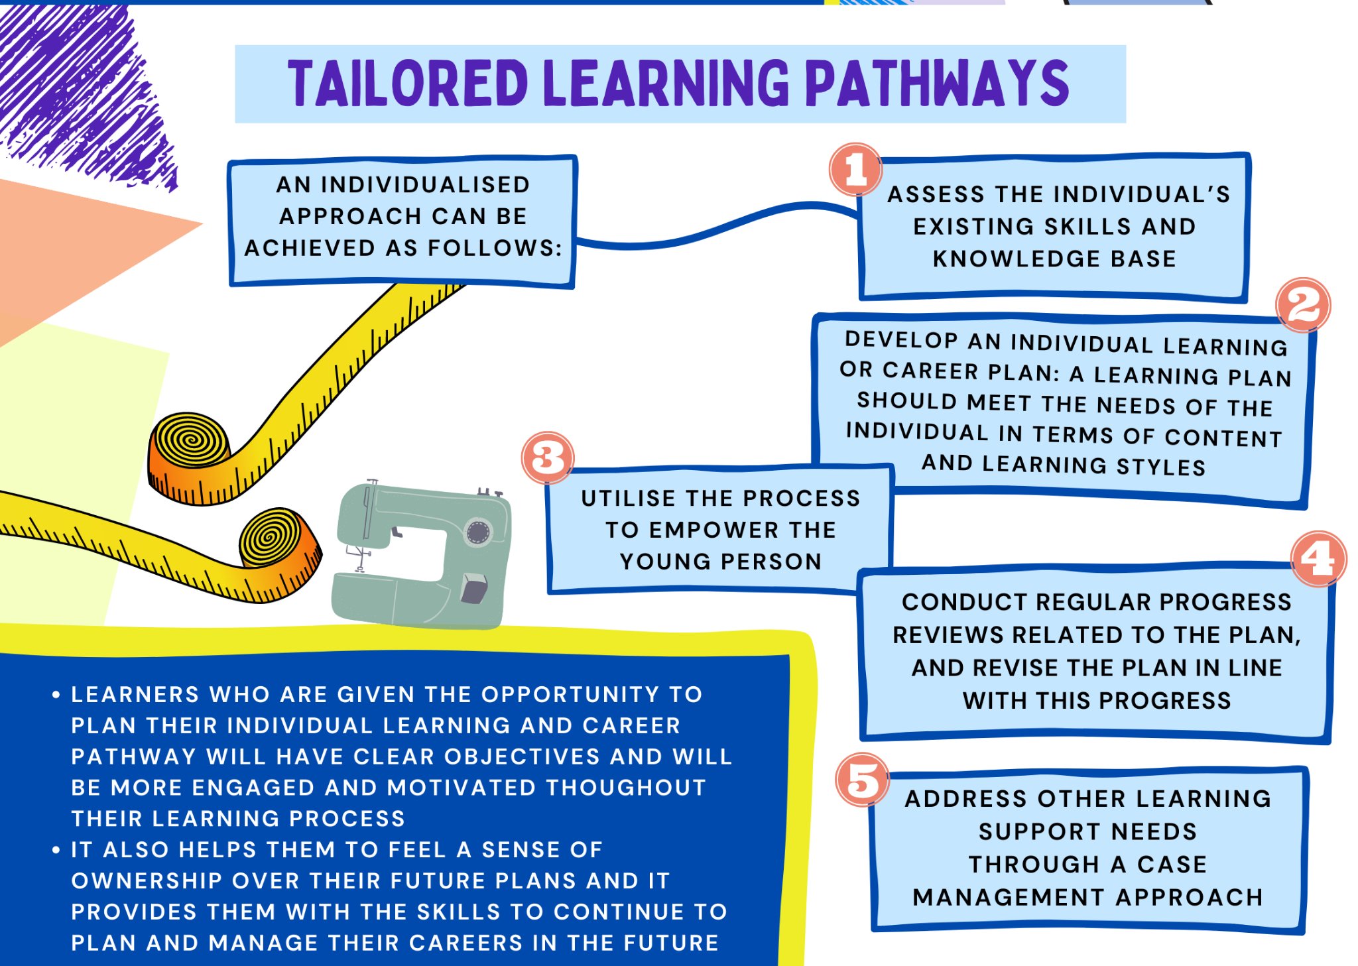
Lodge Farm Education Curriculum Pathway

Slide 8
Lodge Farm Education
What we intend:
•For pupils to be proud of who they are and what they do;
•To provide equal opportunities for all;
•To provide an engaging curriculum;
•To remove obstacles to learning irrespective of
starting points;
•Pupils to take independent accountability for their
learning and behaviour;
•For pupils to have a sense of self-worth and
belonging who can make a positive contribution to
their community
We want our pupils to have a big role in creating both their learning and personal journeys in becoming positive members
of the community.
Next steps are vital – pupils should be actively involved in achieving and setting their next steps.
Pupil engagement is key!
We recognise that young people learn in different
ways but that they learn best when they are motivated
by a curriculum that is stimulating, flexible, fun and
underpinned by key basic skills.
Pupils will be engaged within Lodge Farm Education curriculum and follow one of our two curriculum pathways.
All our pupils will have the opportunity to follow an individualised timetable, which is created to meet
their own specific needs and is produced in accordance with their Education and Health Care Plan (EHCP).
These subjects:
• Allow pupils to re-engage in learning and, due to their strong practical basis, they provide young people with alternative opportunities to be productive and experience success
• Enrich, broaden, enhance, and widen the curriculum offer whilst integrating literacy, numeracy and other core subject learning
• Provide opportunities to promote social skills, interaction, communication and address individualised EHCP targets
• Familiarise pupils with a subject that can be studied in further education

Slide 9



Lodge Farm Education
English Food Technology
Mathematics Design Technology
Science Animal Care
Geography Forest School
History ICT
PSHE Art
As a school, we use computer systems such as IDL and Seneca within our learning.

